Slide 1

Game jam: Research

Slide 2
Idea:
You play as a drunkard in a bar. As you’ve gotten more drunk, you see a ‘figure’ appear to stop you from drinking. You begin to run around the bar, dodging this figure and continuing to drink and build up your score. As you drink more, you will occasionally pass put and become a ghost, allowing you to become faster and scout out the area and explore for more items or layout for the bar. Your score goes up based on the time you dodge for and the amount of alcohol you drink.

Slide 3
Location: Bar
Layout needs to be open
Be able to run around/loop enemy
Enemy can get you no matter what, so layout needs to be hard to navigate
One room: The bar, eating space
Needs to be large, can exaggerate the size
Things look weirder the more you drink

Slide 4
Notes:
Being ghost increases chances of them not getting you, and makes player faster and able to do recon on where items/drinks are
Drink enough alcohol to die
Each reset starts with them taking a drink before becoming more disorderly
When more drunk, you see double and the obstacles double, rooms doubles
Get caught multiple times in a row, you get good ending for not dying from alcohol
Ragdoll AI
Assault others, get more points but risk of getting caught. High risk high reward
Person chasing you is an allegory for your responsibilities, thoughts, feelings etc.

Slide 5
Gameplay:
Start game
Run
Drink
More drinks = more chaotic/more problematic and a higher score
‘Person’ chasing you to stop you drinking
‘Person’ loses you, chance to explore/recon
‘Person’ catches you, you sober up, restart
Successfully reach drink capacity
Die
Cutscene
win

Slide 6

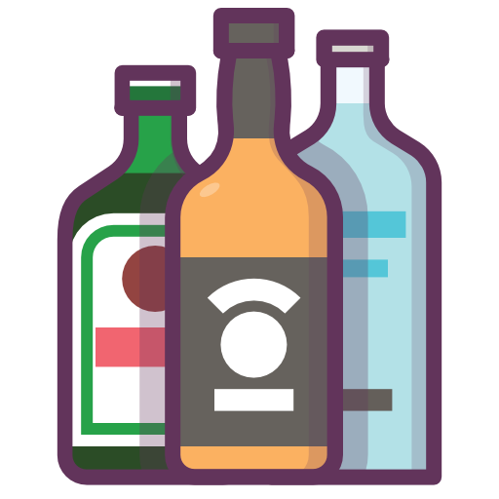
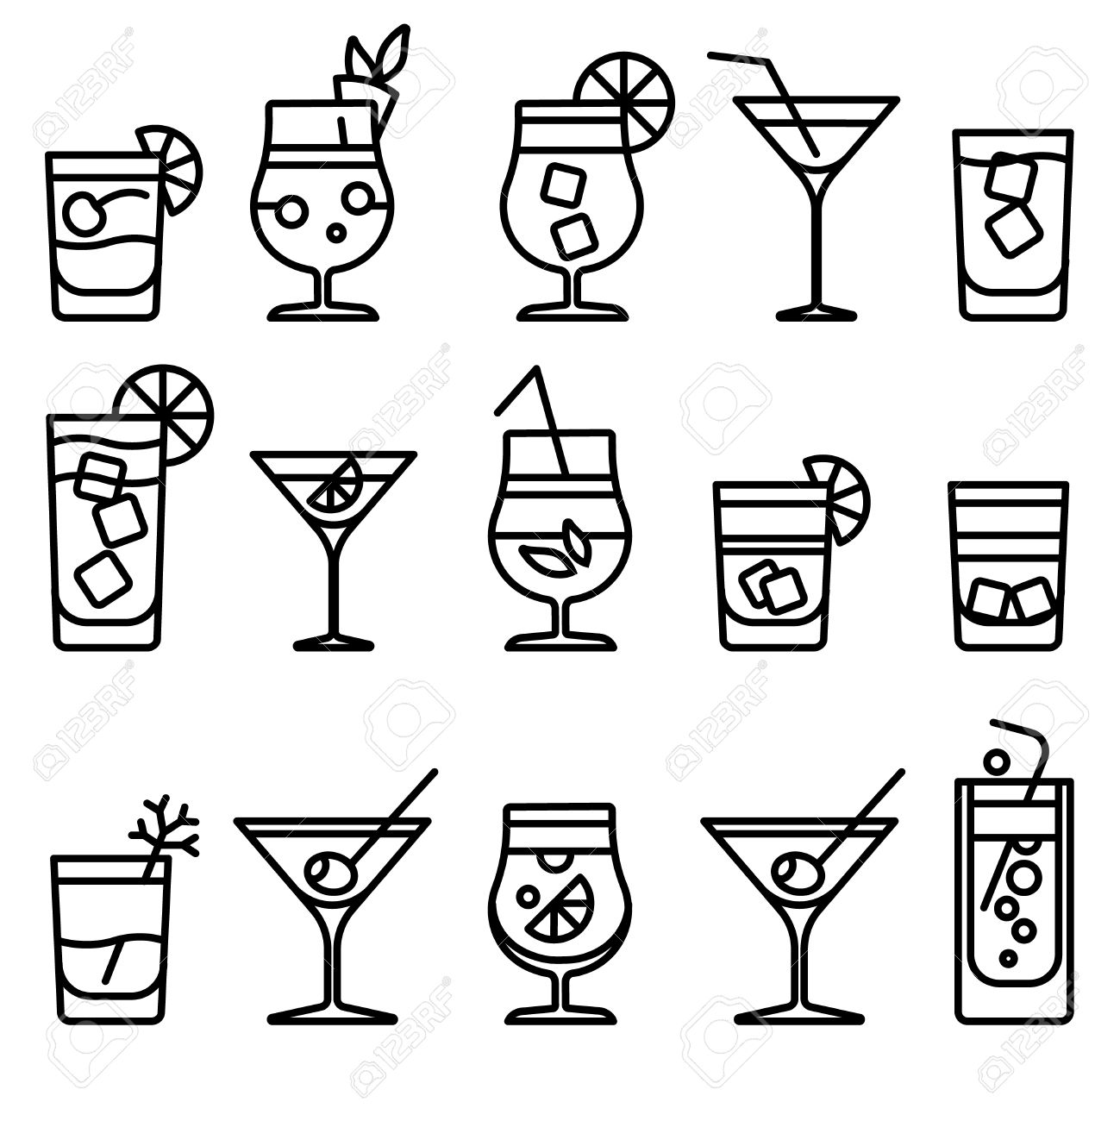
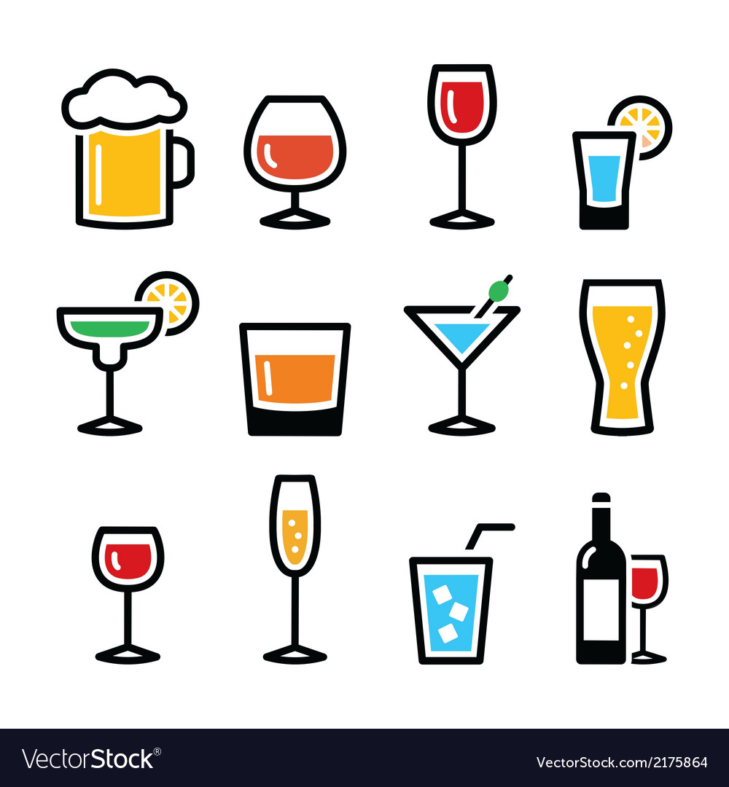
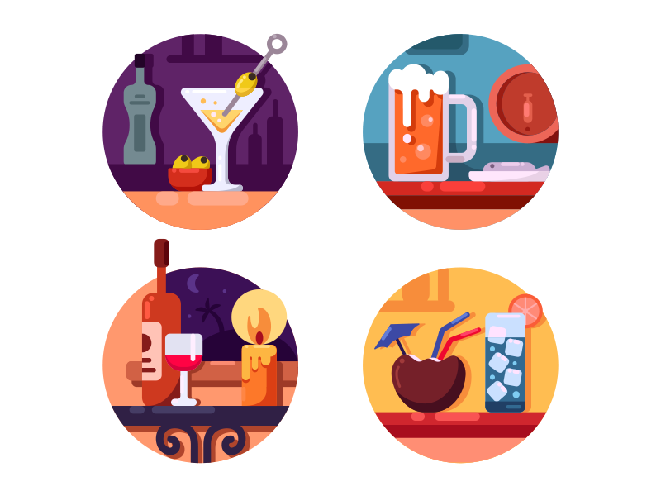
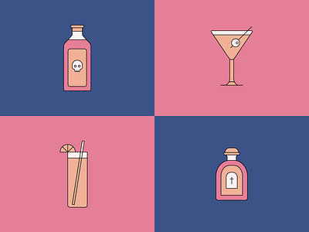

Slide 7
HUD:
Timer (going up)
Score
Drunk scale/meter
Ghost effect
Screen boarder getting darker when figure gets closer

Slide 8
Mechanics:
Move
Dash
Powerup (alcohol) Speed increase, score multiplier etc
Figure chasing the player

Slide 9
References:

Slide 10
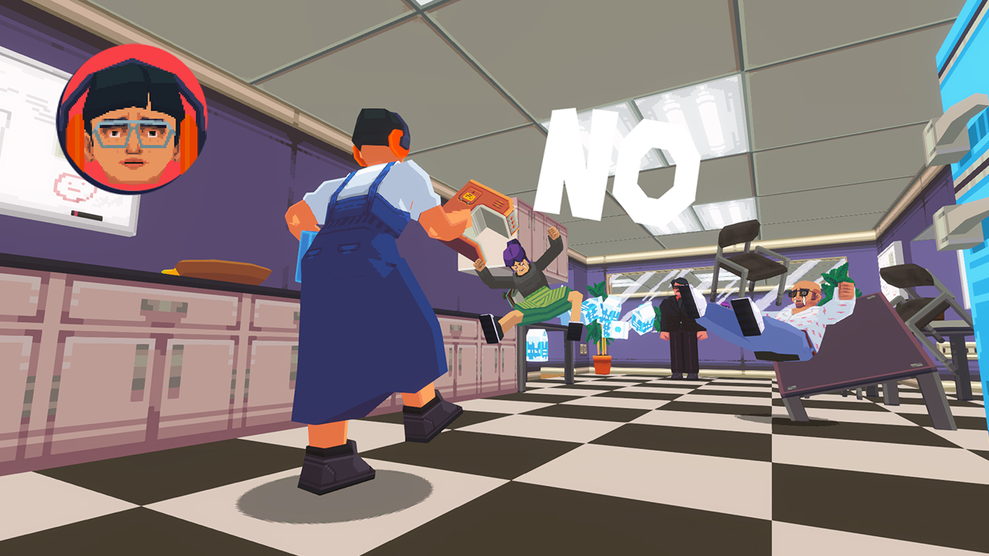
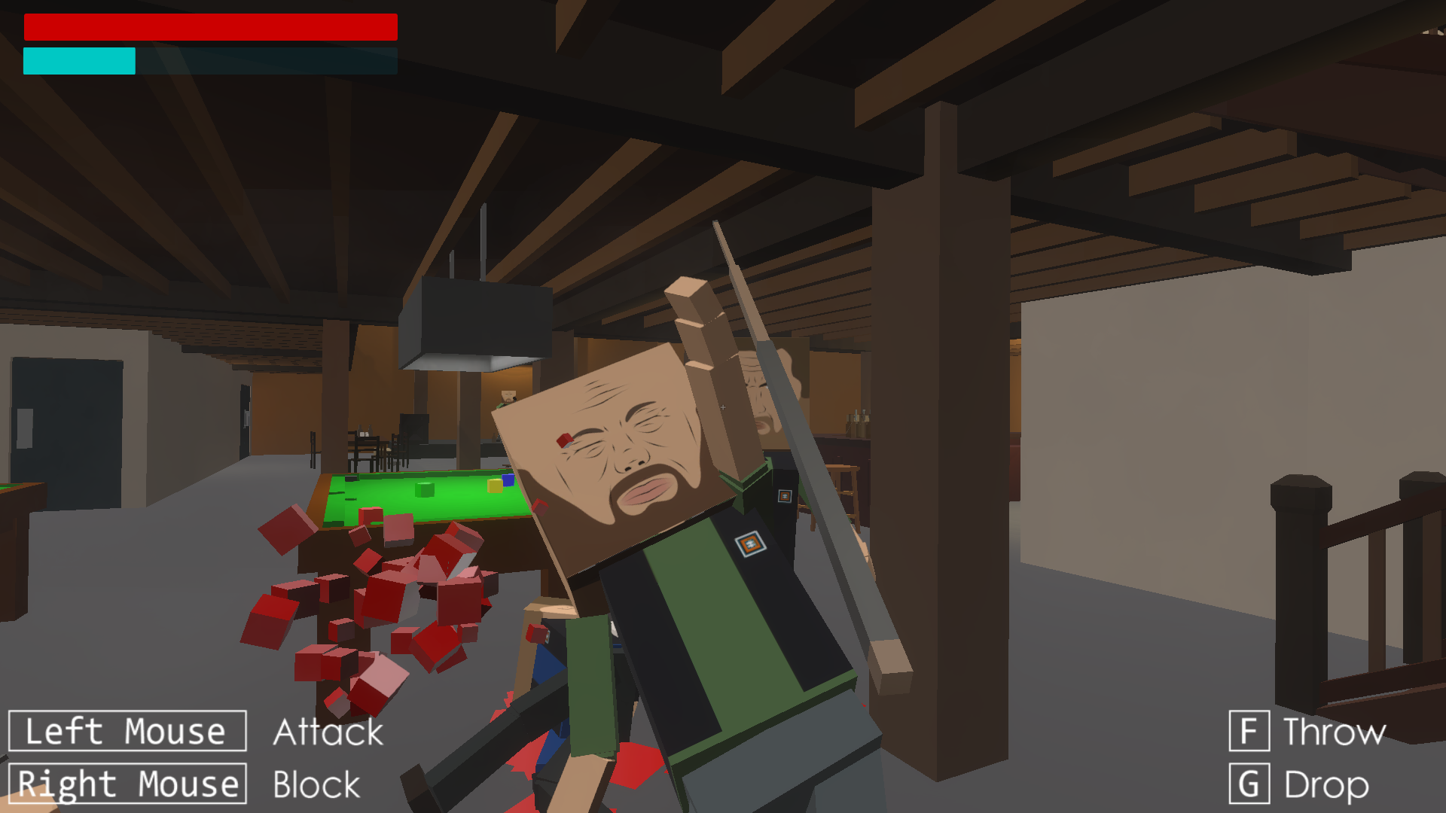
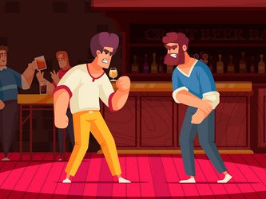
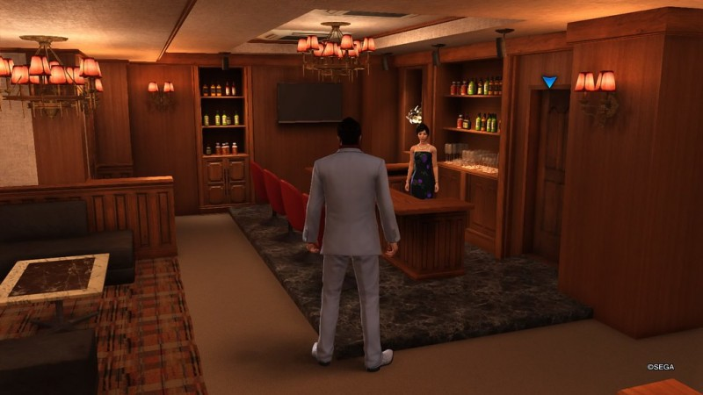
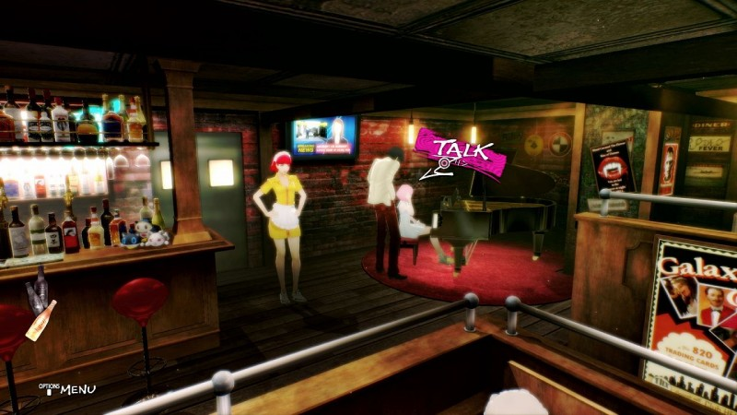

Slide 11
Layout

Slide 12
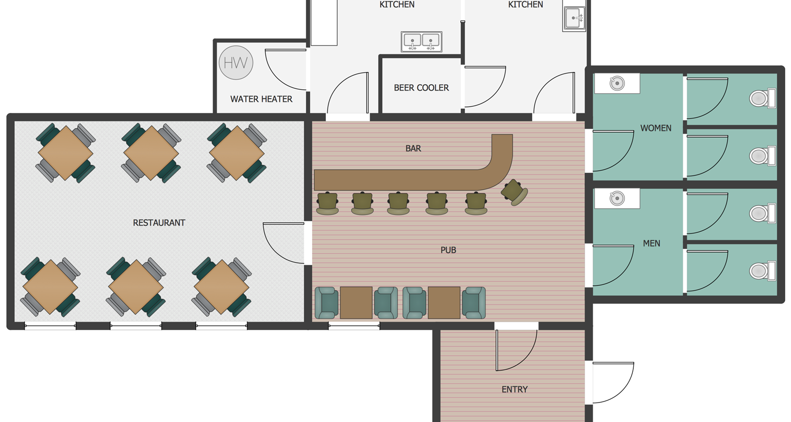
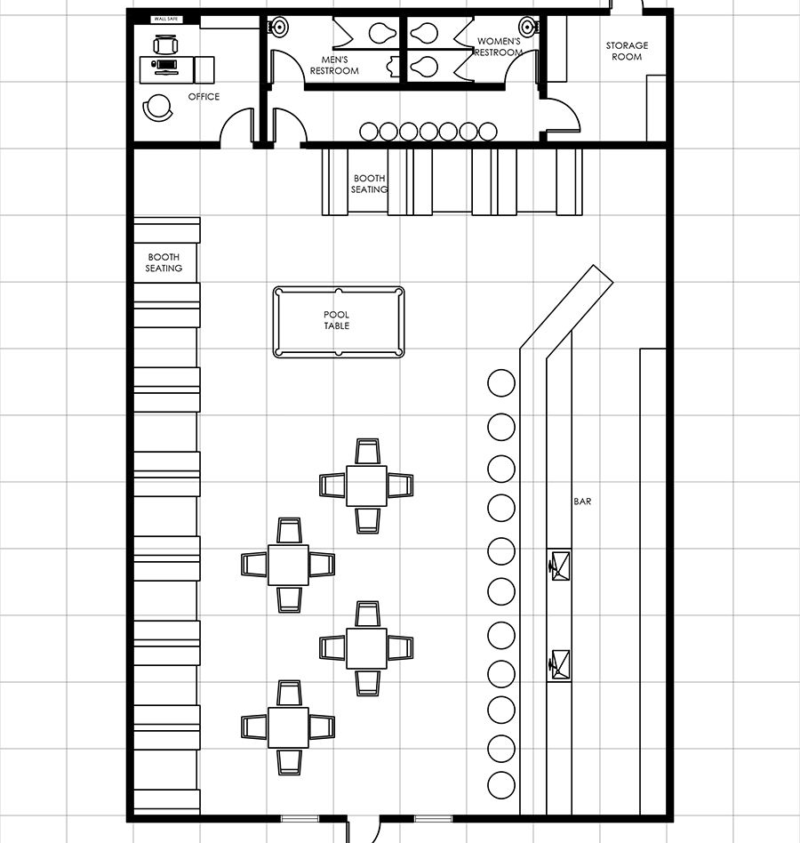
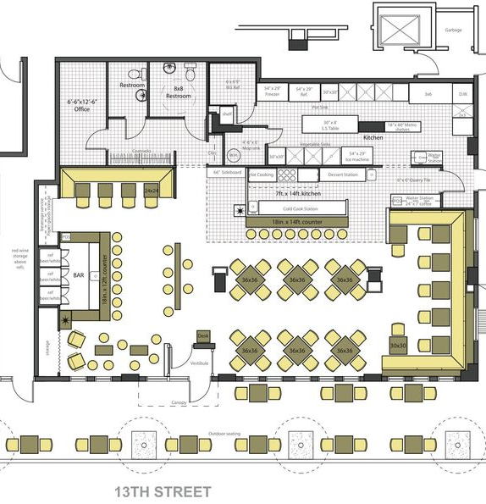
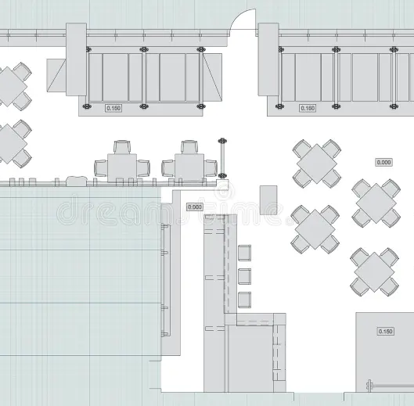

Slide 13
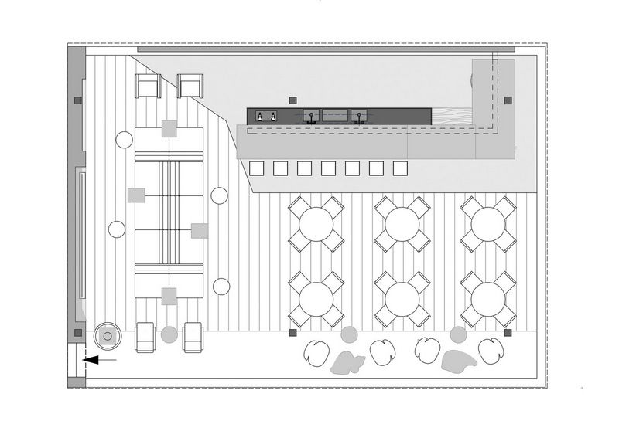
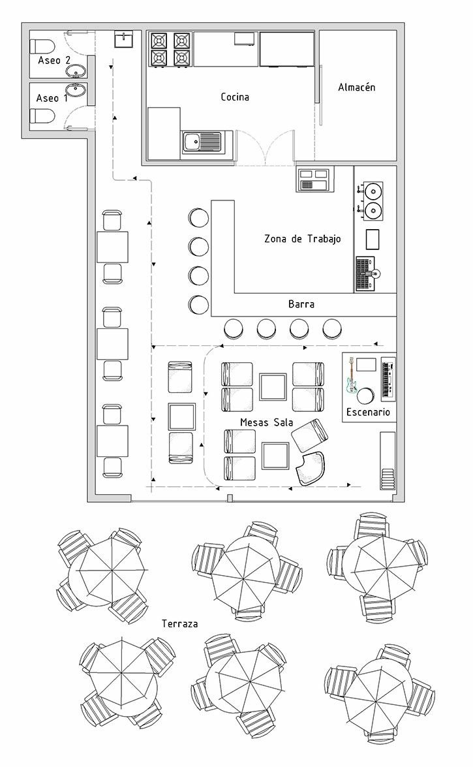
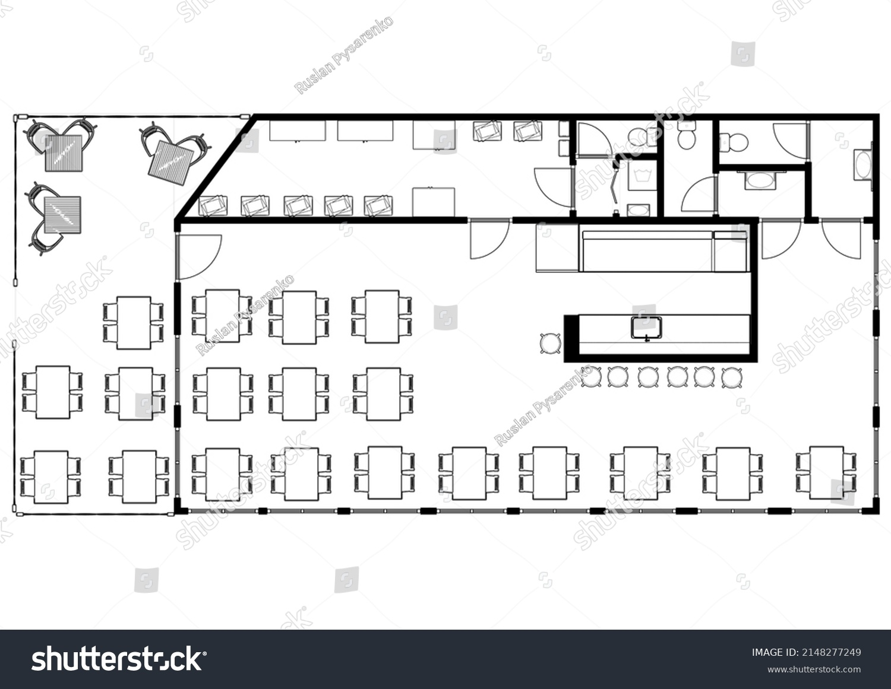
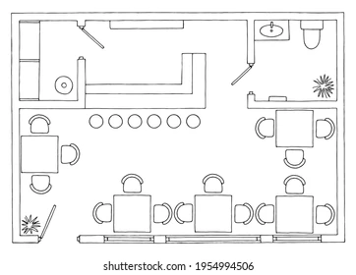

Slide 14
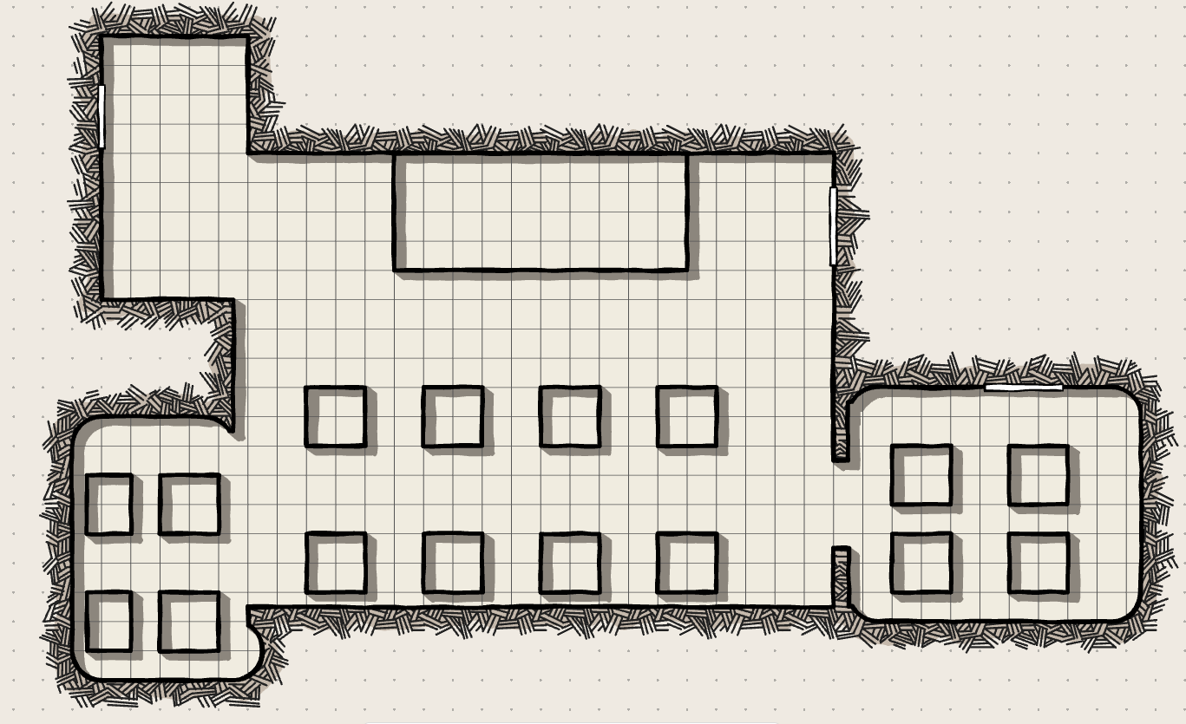
Bar
Table

Slide 15
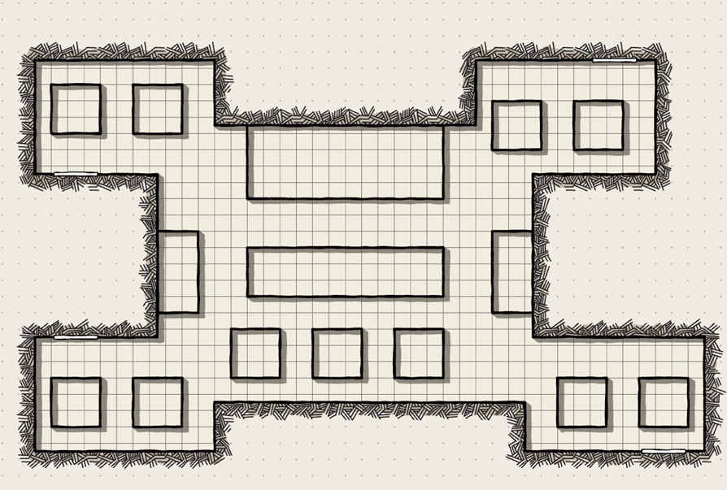
Bar
Pool Table
Tables

Slide 16
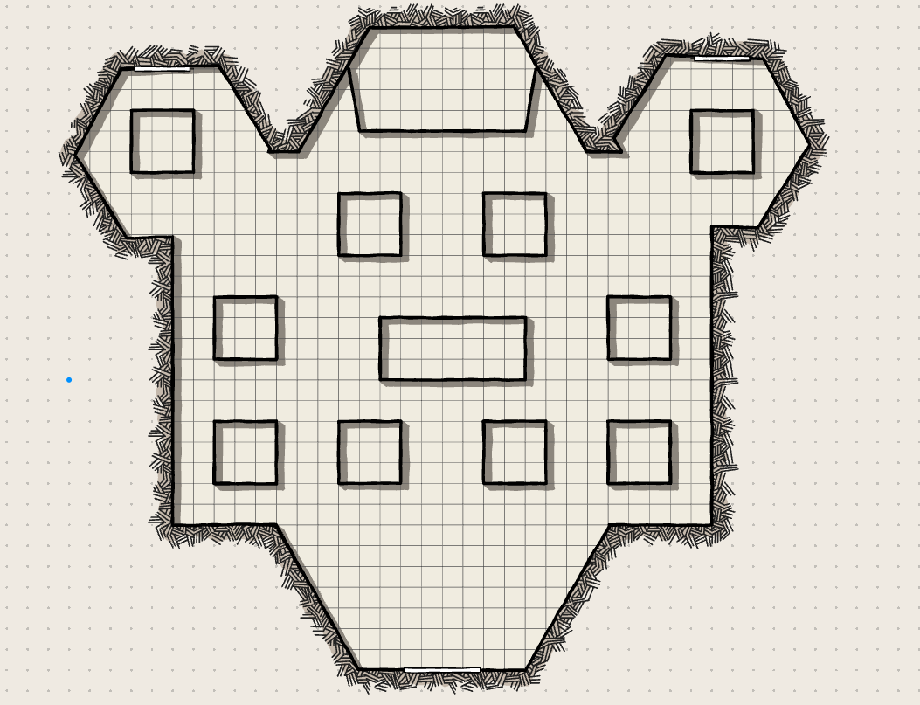
Bar
Pool Table
Tables

Slide 17
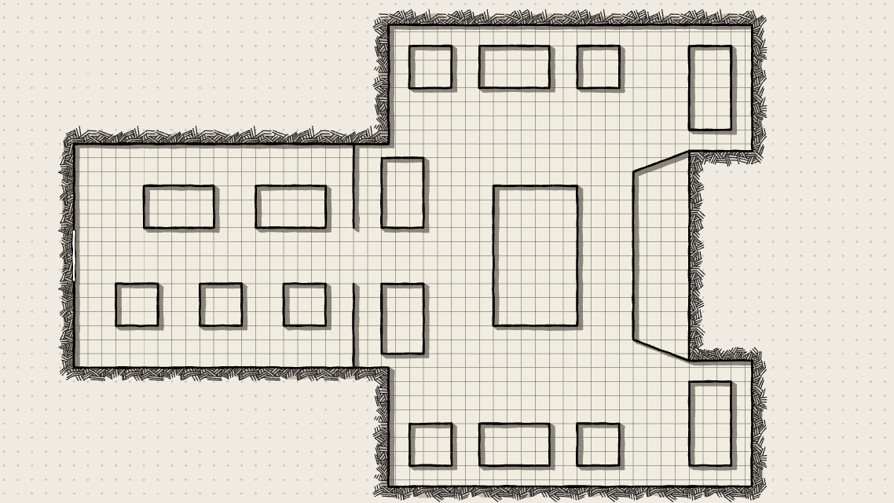
Tables
Bar
Pool Table

Slide 18
